Slide 1
Data Link Layer
Sliding Window Protocol

Slide 2
Sliding Window Protocol
Data link layer protocols for reliable and sequential delivery of data frames.
The sliding window is also used in Transmission Control Protocol.
In this protocol, multiple frames can be sent by a sender at a time before receiving an acknowledgment from the receiver.
The term sliding window refers to the imaginary boxes to hold frames.
Sliding window method is also known as windowing.

Slide 3
Sliding Window Protocol
The sender has a buffer called the sending window and the receiver has buffer called the receiving window.
If the sequence number of the frames is an n-bit field, then the range of sequence numbers that can be assigned is 0 to 2^{𝑛}−1.
Consequently, the size of the sending window is 2^{𝑛}−1.

Slide 4
Sliding Window Protocol
if the sending window size is 4, then the sequence numbers will be 0, 1, 2, 3, 0, 1, 2, 3, 0, 1, and so on.
The number of bits in the sequence number is 2 to generate the binary sequence 00, 01, 10, 11.
The size of the receiving window is the maximum number of frames that the receiver can accept at a time.
It determines the maximum number of frames that the sender can send before receiving acknowledgment.

Slide 5
sender window = receiver window = 4.
So the sequence numbering of both the windows will be 0,1,2,3,0,1,2

Slide 6
The size of the sender window is at most 2k-1.
For example; if 4 bits are allowed by the frame then the size of the window is 2 raised to the power 4 -1 16-1=15.
The buffer is provided to the sender that has the size equal to the size of the window.

Slide 7
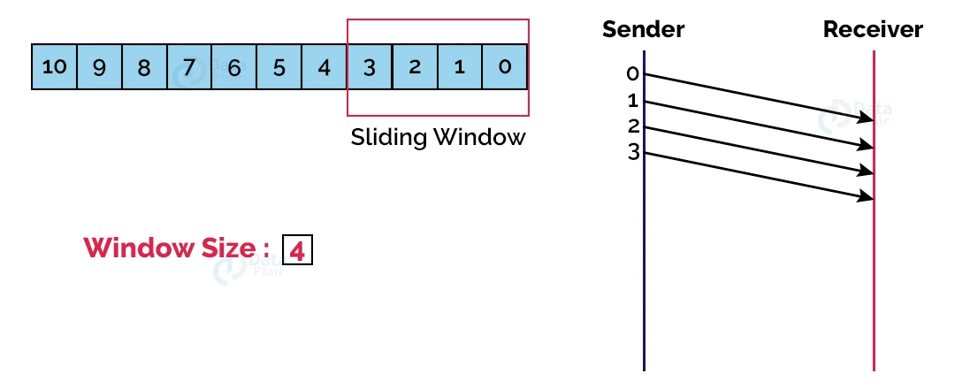
First, the sender sends the first four frames in the window (here the window size is 4).

Slide 8
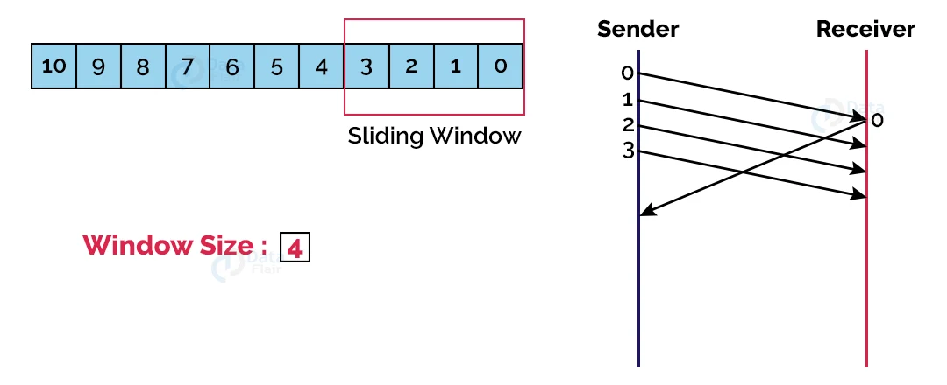
Then, the receiver sends the acknowledgment for the 0th frame.

Slide 9
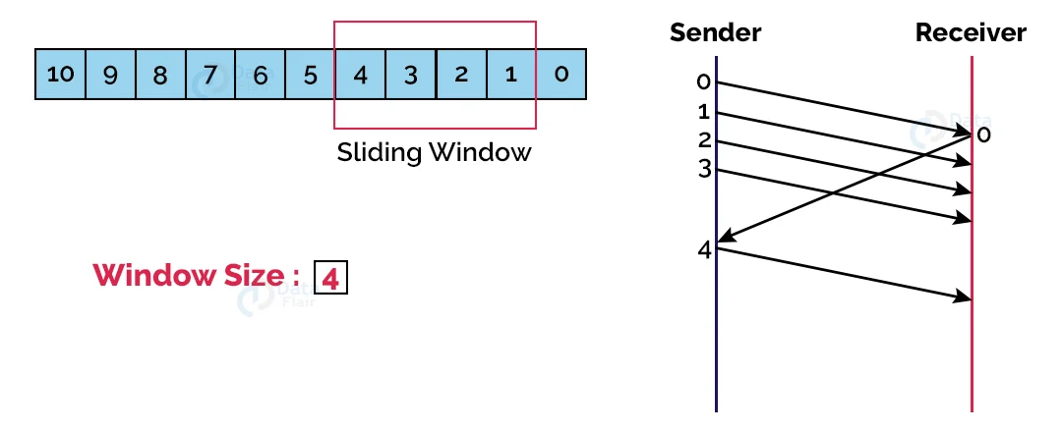
The receiver then slides the window over and sends the next frame in the queue.

Slide 10
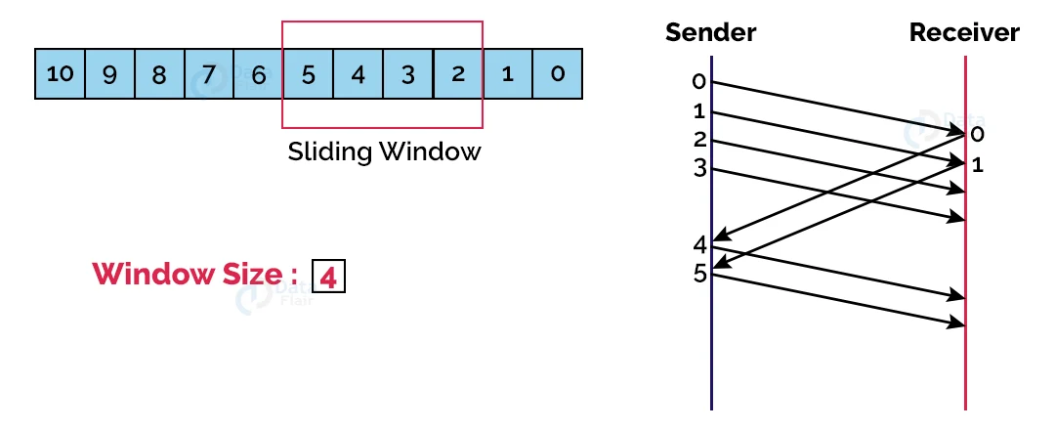
Accordingly, the receiver sends the acknowledgement for the 1st frame, and upon receiving that, the sender slides the window again and sends the next frame. This process keeps on happening until all the frames are sent successfully.

Slide 11
Types of Sliding Window Protocols:
1. Go-Back-N ARQ:
The Go-Back-N Automatic Repeat Request protocol is also known as the Go-Back-N ARQ protocol.
In the event of corruption or loss of frames, all subsequent frames must be sent again.
In this protocol, the sender window size is N. The size of the receiver window is always one.
In the event of transmission of a corrupted frame, the receiver cancels it. The receiver does not accept a corrupted frame. The sender sends the correct frame again when the timer expires.

Slide 12
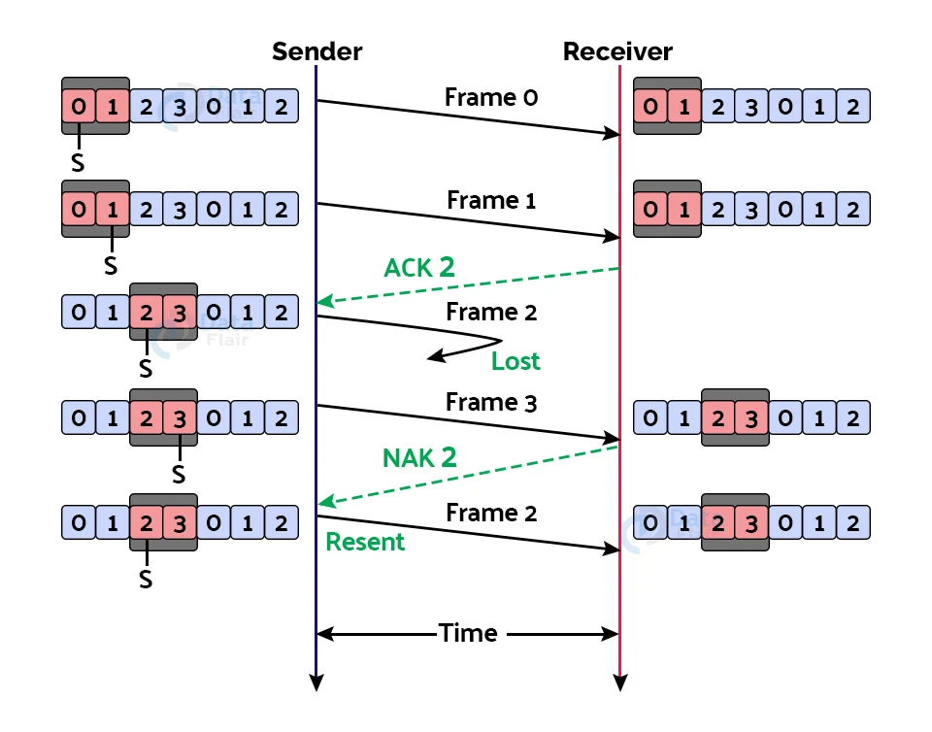

Slide 13
2. Selective Repeat ARQ:
Also known as Selective Repeat Automatic Repeat Request.
The size of the sender window is always equal to the size of the receiver window in this protocol. The sliding window’s size is always greater than 1.

Slide 14


Slide 15
2. Selective Repeat ARQ:
First, the sender sends the contents of the first window, which are frames 0 and 1 (because the window size is 2).
b. When the receiver receives the frames sent above, it sends an acknowledgment for frame 2 (because frame 2 is the frame it expects to receive next).
c. The sender then sends frames 2 and 3, however, frame 2 is lost on the way. The receiver thus sends back a “NAK” signal or a non-acknowledgment to let the sender know that frame 2 has been lost, and thus the sender retransmits frame 2.

